Slide 1



Supersonic Wind Tunnel Diffuser Improvements for Increased Run Time
Arizona/NASA Space Grant Symposium
April 13, 2019
Jacklyn Higgs
Advisor Dr. Jesse C. Little
The University of Arizona
Aerospace and Mechanical Engineering

Slide 2

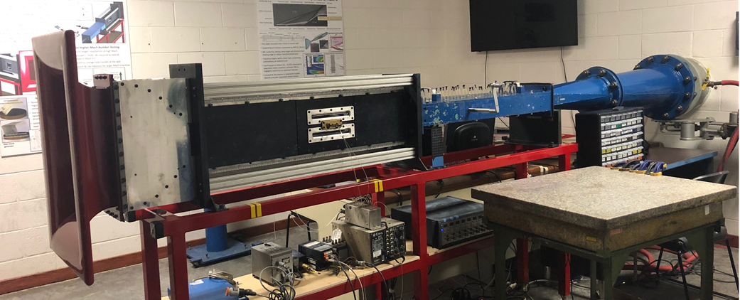
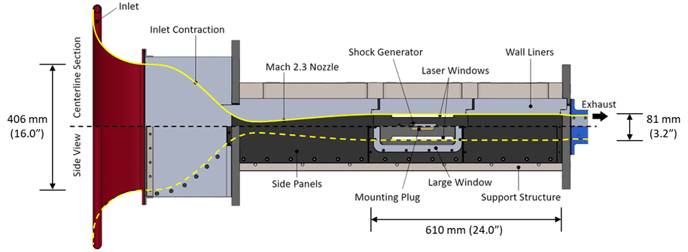
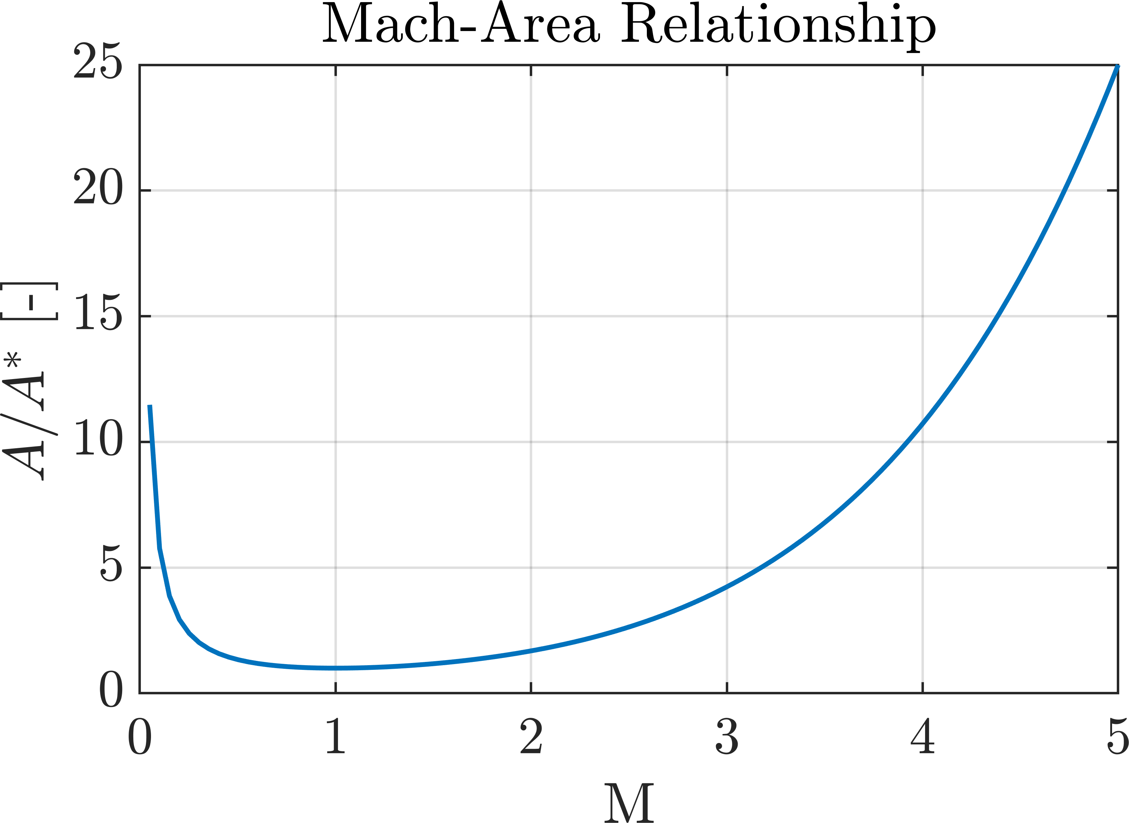

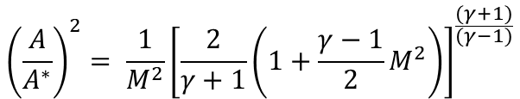

Supersonic Wind Tunnel
Mach Number: ratio of velocity to the speed of sound
Subsonic: Mach < 1
Sonic: Mach = 1
Supersonic: M > 1
$$M= \frac{v}{a}= \frac{v}{\sqrt{γRT}}$$
$${\left(\frac{A}{A^{∗}}\right)}^{2}= {\frac{1}{M^{2}}\left[\frac{2}{γ+1}\left(1+\frac{γ−1}{2}M^{2}\right)\right]}^{\frac{(γ+1)}{(γ−1)}}$$
For M= 4 A/A* = 10.72
Threadgill (2018)
In-draft Supersonic Wind Tunnel
Test Section: 4.8”x5.2”x24”
Vacuum chamber: 1200 ft³
Runs at M=2.3 and M=4
Notes:
Explain Nozzle and Test section here
Mention what the throat is point to it
Area ratio sets the Mach number - minimum
Area ratio graph and show trend

Slide 3

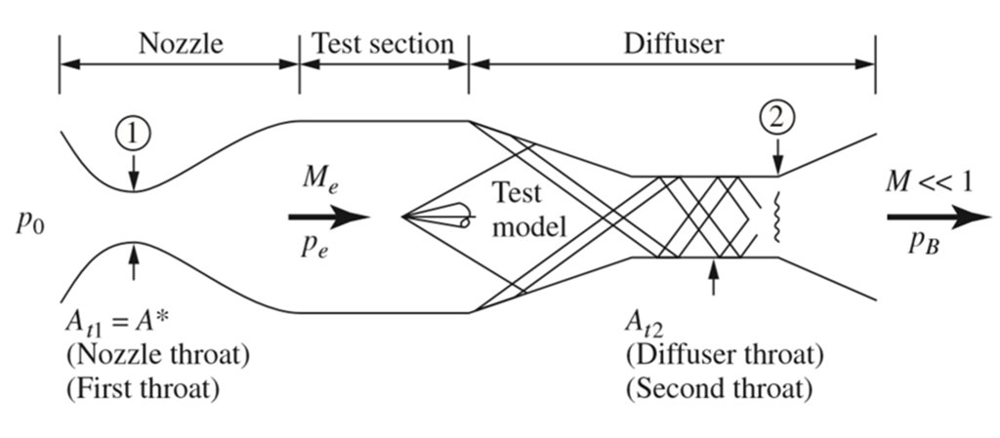


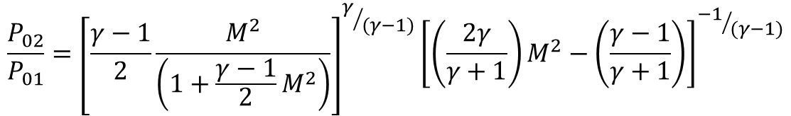
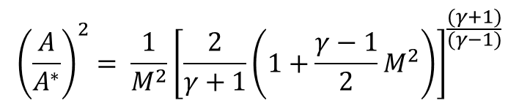
The Diffuser
Purpose: reduces pressure ratio required to run the tunnel
Requires a large pressure ratio between ambient air and downstream vacuum tank
Run time limited by size of tank and total pressure loss
Too small a diffuser throat causes shock to stand inside the nozzle
Similar process for air breathing propulsion
$${\left(\frac{A}{A^{∗}}\right)}^{2}= {\frac{1}{M^{2}}\left[\frac{2}{γ+1}\left(1+\frac{γ−1}{2}M^{2}\right)\right]}^{\frac{(γ+1)}{(γ−1)}}$$
For M=4 A/A* = 10.72
For M=2.3 A/A* = 2.19
For M=1.1 A/A* = 1.01
Anderson (2017)
$$\frac{P_{02}}{P_{01}}={\left[\frac{γ−1}{2}\frac{M^{2}}{\left(1+\frac{γ−1}{2}M^{2}\right)}\right]}^{γ/{(γ−1)}}{\left[\left(\frac{2γ}{γ+1}\right)M^{2}−\left(\frac{γ−1}{γ+1}\right)\right]}^{{−1}/{(γ−1)}}$$
Shock wave – abrupt change in fluid properties due to the coalescence of sound waves
Notes:
Series of Oblique shock that turns into a weak shock for less pressure losses
Same process happens in ramjets – air breathing propulsion

Slide 4

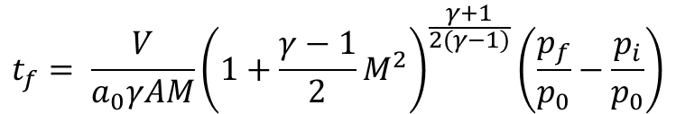

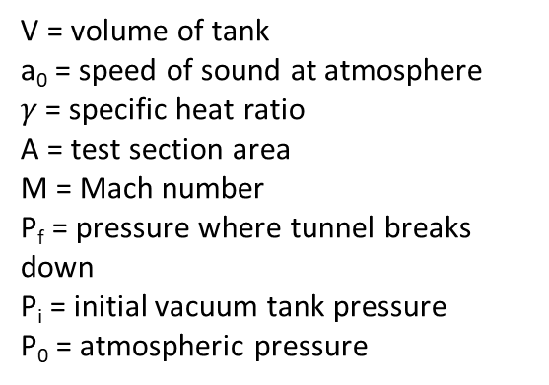
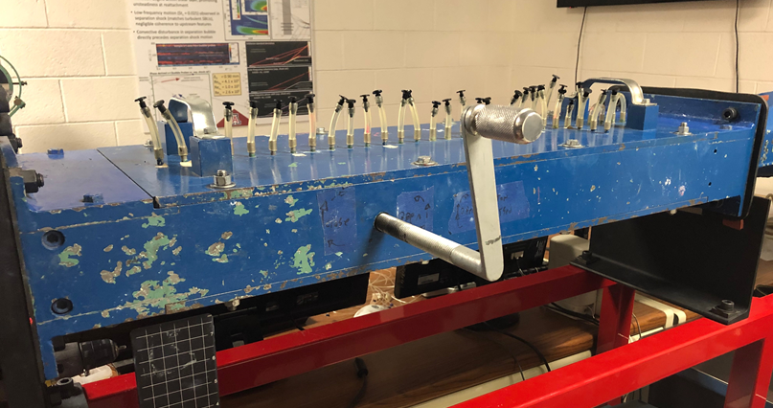

The Problem: The Diffuser
With a wide, diffuser throat run time is limited to 10 seconds
Worn and outdated system preventing diffuser throat size to vary
Takes 2 people to turn cranks, cannot know exactly how far diffuser wall is moved
Want longer run time to take more data per run
$t_{f,max}$ = 135 s
Direction of Flow
Notes:
More efficient because: tank fills up with less pressure, takes longer to break down. Less wait time between runs waiting for vacuum tank to empty.
Higher Mach -> larger pressure difference ->p decreases more across the shock -> vacuum tank does not fill up as fast
Pf/p0 is the important factor
Larger p ratio larger t

Slide 5
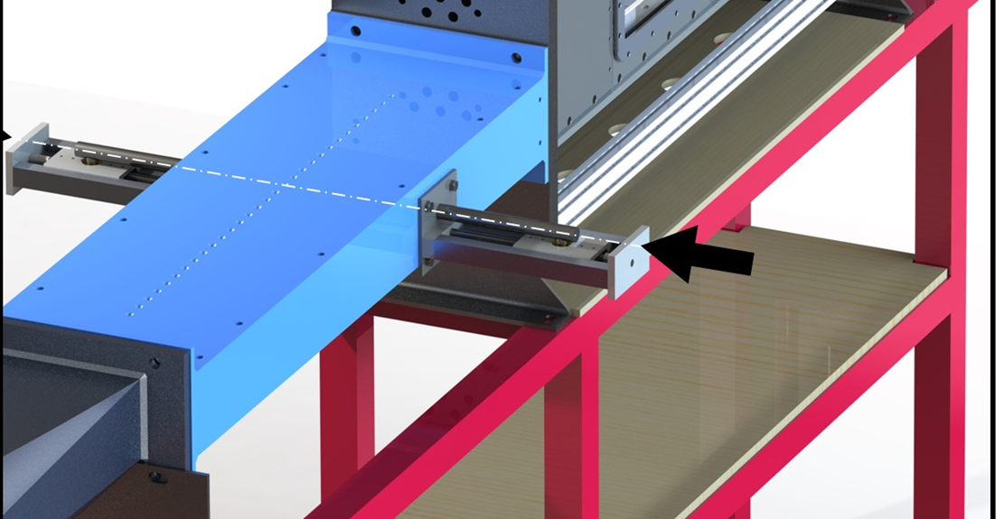
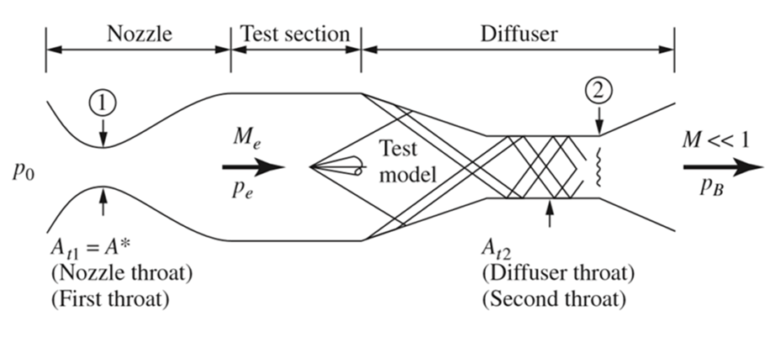
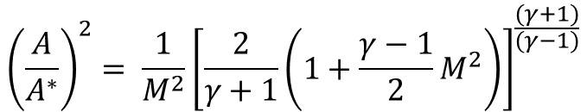
Objective/What did I do?
Overall Objective: extend tunnel run time
Developed a new mechanism to vary the diffuser throat area
Calculated travel distance, measured force, found new theoretical runtime
Developed SolidWorks design
Threadgill (2018)
$${\left(\frac{A}{A^{∗}}\right)}^{2}= {\frac{1}{M^{2}}\left[\frac{2}{γ+1}\left(1+\frac{γ−1}{2}M^{2}\right)\right]}^{\frac{(γ+1)}{(γ−1)}}$$
Torque = 2.828 ft-lb
For M = 4 ΔX = 2.15 in.
Anderson (2017)
Notes:
Torque = 2.828 ft-lbf = 33.936 in-lbf
Arm ~ 10 inches
Force = 3.2 pounds?

Slide 6
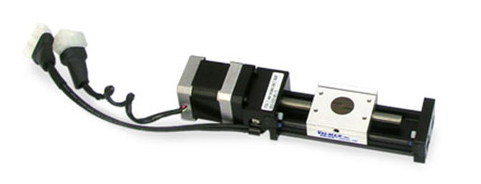
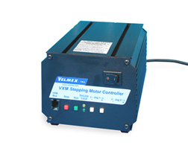
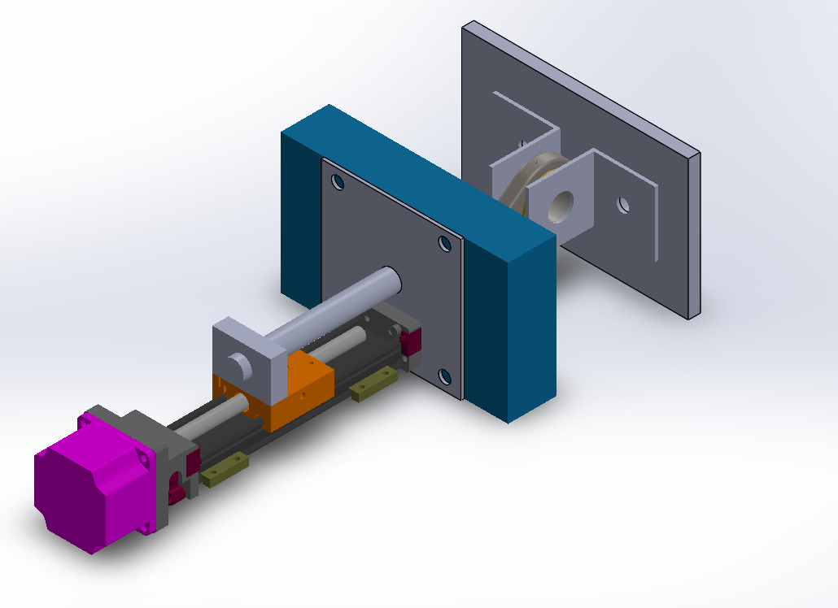
New System and Modifications
Motor driven, modified Velmex Slider
4” travel distance XSlide
Single shaft stepper motor
Up to 100 lb. load
Speed: 2 inches/sec
VXM-1-1 programmable controller
Velmex (2019)
Velmex (2019)
Outer tunnel wall
Inside Diffuser wall
Replace large screw with smooth rod
Clamp onto sliding stage
Replace the worn braces with L-Brackets and ball joint rod end
Allows for slight moment and rotation
Minimizes friction effects and wear
Smooth rod and clamp
L-Brackets and ball joint rod end
XSlide and motor

Slide 7
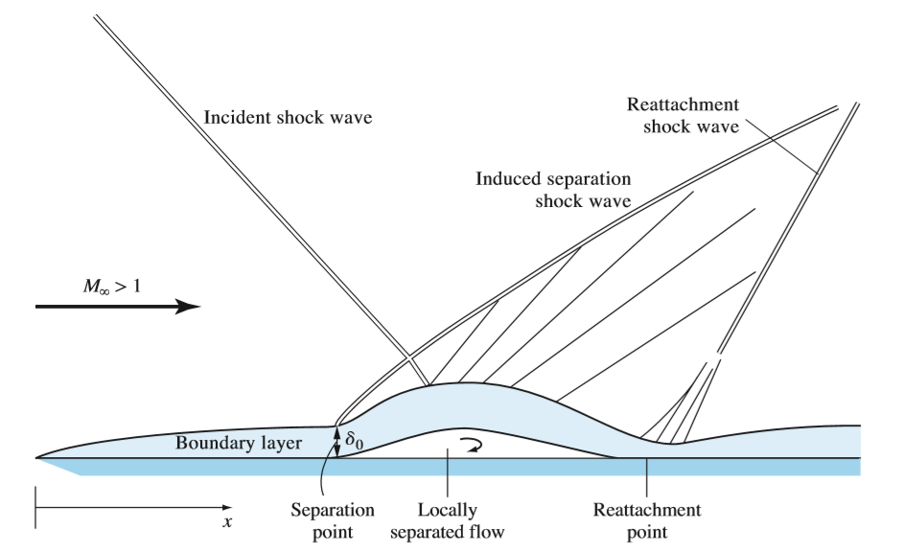
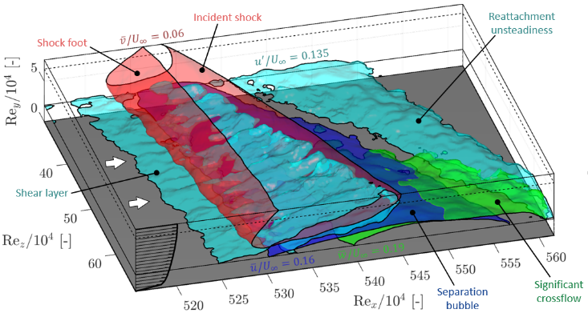
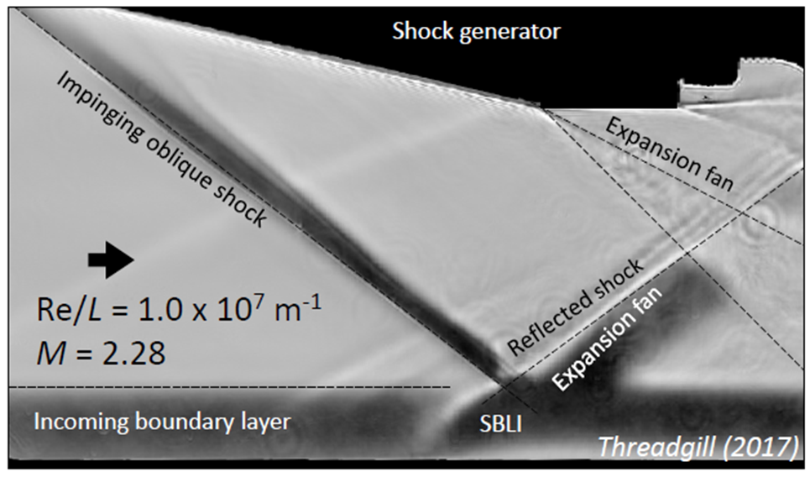
Expected Outcomes
Application: Shockwave Boundary Layer Interaction (SBLI)
Particle Image Velocimetry (PIV) data acquired at 10 Hz
Existing run time (10 sec) yields 100 samples
Desire >1,000 samples
Theoretical runtime ~135 seconds
Anderson (2017)
Threadgill (2018)
Notes:
All the analysis is for inviscid, viscous effects (SBLI) are important
Get schlieren photo, mean picture of SBLI
PIV – flow filled with particles and visualized with a laser sheet and camera
Want it to run longer for SBLI – state as an example
Shock has an adverse pressure gradient causes BL to oscillate and separate
High heating at separation and reattachment – localized regions of high heating
High pressure and heating leads to damage
Application: Shockwave Boundary Layer Interaction (SBLI)
Want larger data sets - greater samples for Particle Image Velocimetry (PIV) to characterize the SBLI
PIV data acquired at 10 Hz
10 seconds yields 100 samples, we need 1,000 samples
Existing runtime ~10 seconds
Theoretical runtime ~135 seconds

Slide 8
Acknowledgements
Arizona/NASA Space Grant
The University of Arizona
Airforce Office of Scientific Research (AFOSR)
Raytheon Missile Systems
Advisor – Dr. Jesse C. Little
Post Doctoral – Dr. James A. S. Threadgill
Ph.D. - Jorge Castro Maldonado
- Sathyan Padmanabhan
Undergraduate – Lindsey Urh

Slide 9
References
[1]. Fundamentals of Aerodynamics, Anderson, John, 2017, New York: McGraw-Hill Education.
[2]. Threadgill, J. A. S, “Private Communication”, 2019.
[3]. Velmex, Inc. https://www.velmex.com/Products/XSlide/XSlide-motorized.html.

Slide 10
Thank You

